Slide 1
LOAN DEFAULT PREDICTION
By Bhagyasri Nagarajan

Slide 2
LENDING CLUB ANALYSIS OVERVIEW
Identifying the Business Problem
Data Description
Identifying relationship between variables
Data Preparation & Processing
Models
Logistic Regression
Decision Tree
Random Forest
Gradient Boosting
Conclusion & Recommendations

Slide 3
IDENTIFYING THE BUSINESS PROBLEM
Lending Club is a Peer-to-Peer lending company that utilizes a group of private investors to fund loan requests.
Lending Club’s model for risk assessment categorizes borrowers by assigning them a grade and a subgrade based on their credit history.
Investors are presented with a list of borrowers, along with their assigned risk assessment grades, and they have the opportunity to choose which borrowers they will fund, and the percentage of funding that they will cover.
Our business problem is that investors require a more comprehensive assessment of these borrowers than what is presented by Lending Club in order to make a smart business decision, by identifying new borrowers that would likely default on their loans.

Slide 4
DATA DESCRIPTION
Lending Club provided us with 8 years of historical data (2007-2015).
This dataset contained information pertaining to the borrower’s past credit history and Lending Club loan information. The total dataset consists of over 800,000 records.
Variables present within the dataset provided an ample amount of information which we could use to identify relationships and gauge their effect upon the success or failure of a borrower fulfilling the terms of their loan agreement.
Number of rows and columns : Out[109]: (855969, 73)

Slide 5
Identifying X and Y variable:
X is independent variable (e.g. Loan_amt, int, verification_staus etc.).
Y is dependent variable(Default_ind).

Slide 6
Few variables with description
LoanStatNew | Description
addr_state | The state provided by the borrower in the loan application
annual_inc | The self-reported annual income provided by the borrower during registration.
annual_inc_joint | The combined self-reported annual income provided by the co-borrowers during registration
application_type | Indicates whether the loan is an individual application or a joint application with two co-borrowers
collection_recovery_fee | post charge off collection fee
collections_12_mths_ex_med | Number of collections in 12 months excluding medical collections
delinq_2yrs | The number of 30+ days past-due incidences of delinquency in the borrower's credit file for the past 2 years
desc | Loan description provided by the borrower
dti | A ratio calculated using the borrower’s total monthly debt payments on the total debt obligations, excluding mortgage and the requested loan, divided by the borrower’s self-reported monthly income.
dti_joint | A ratio calculated using the co-borrowers' total monthly payments on the total debt obligations, excluding mortgages and the requested loan, divided by the co-borrowers' combined self-reported monthly income
earliest_cr_line | The month the borrower's earliest reported credit line was opened
emp_length | Employment length in years. Possible values are between 0 and 10 where 0 means less than one year and 10 means ten or more years.
emp_title | The job title supplied by the Borrower when applying for the loan.
funded_amnt | The total amount committed to that loan at that point in time.
funded_amnt_inv | The total amount committed by investors for that loan at that point in time.
grade | XYZ corp. assigned loan grade
home_ownership | The home ownership status provided by the borrower during registration. Our values are: RENT, OWN, MORTGAGE, OTHER.
id | A unique assigned ID for the loan listing.
initial_list_status | The initial listing status of the loan. Possible values are – W, F
inq_last_6mths | The number of inquiries in past 6 months (excluding auto and mortgage inquiries)
installment | The monthly payment owed by the borrower if the loan originates.
int_rate | Interest Rate on the loan
issue_d | The month which the loan was funded
last_credit_pull_d | The most recent month XYZ corp. pulled credit for this loan
last_pymnt_amnt | Last total payment amount received
last_pymnt_d | Last month payment was received
loan_amnt | The listed amount of the loan applied for by the borrower. If at some point in time, the credit department reduces the loan amount, then it will be reflected in this value.
loan_status | Current status of the loan

Slide 7
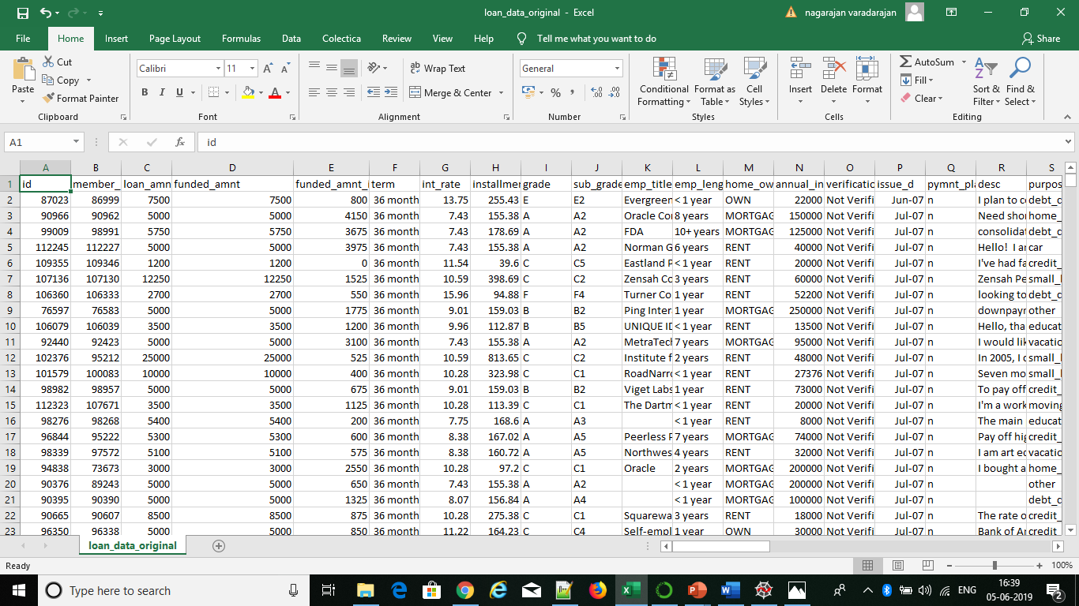
Original Data

Slide 8
Identifying relationship between variables
We will try to identify relationship between few variables in order to understand dataset
In the following slides we will see graphical representation of relationship between following variables :

Slide 9
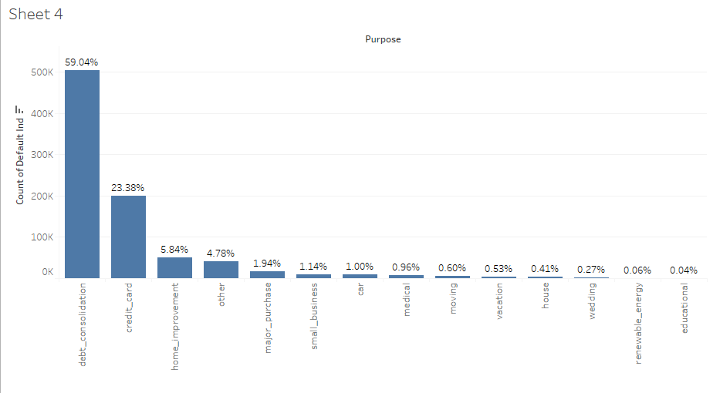
Major Purpose of borrowing
Top 3 purpose Contribute ~ 90% of funding

Slide 10
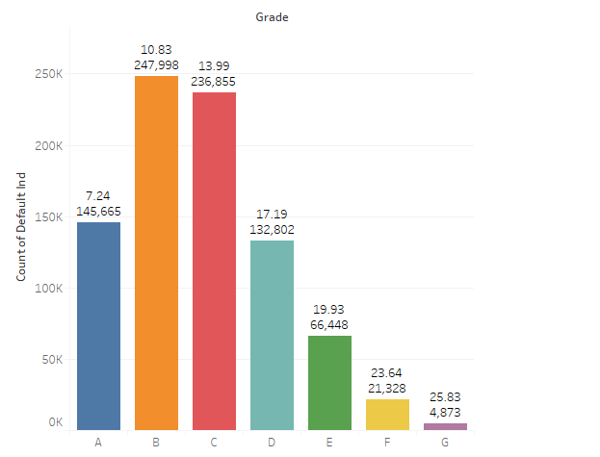
Segmenting Borrower and Average Interest Rate

Slide 11
Higher the interest rate higher is the Default rate
Grade | A | B | C | D | E | F | G | Total
Total Borrower | 145665 | 247998 | 236605 | 132802 | 66448 | 21328 | 4873 | 855719
Non Defaulters | 143001 | 238281 | 223583 | 122004 | 59989 | 18315 | 4059 | 809232
Defaulters | 2664 | 9717 | 13022 | 10798 | 6459 | 3013 | 814 | 46487
Default Rate | 1.9% | 4.1% | 5.8% | 8.9% | 10.8% | 16.5% | 20.1% | 5.7%

Slide 12
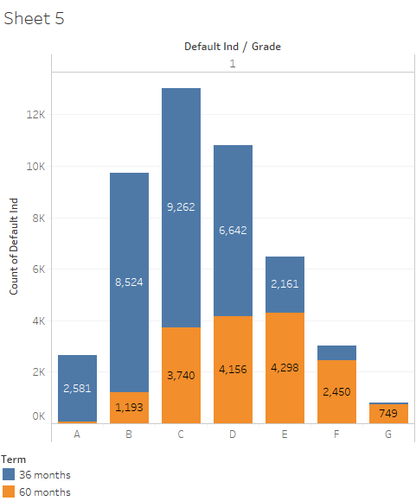
Term wise defaulters

Slide 13
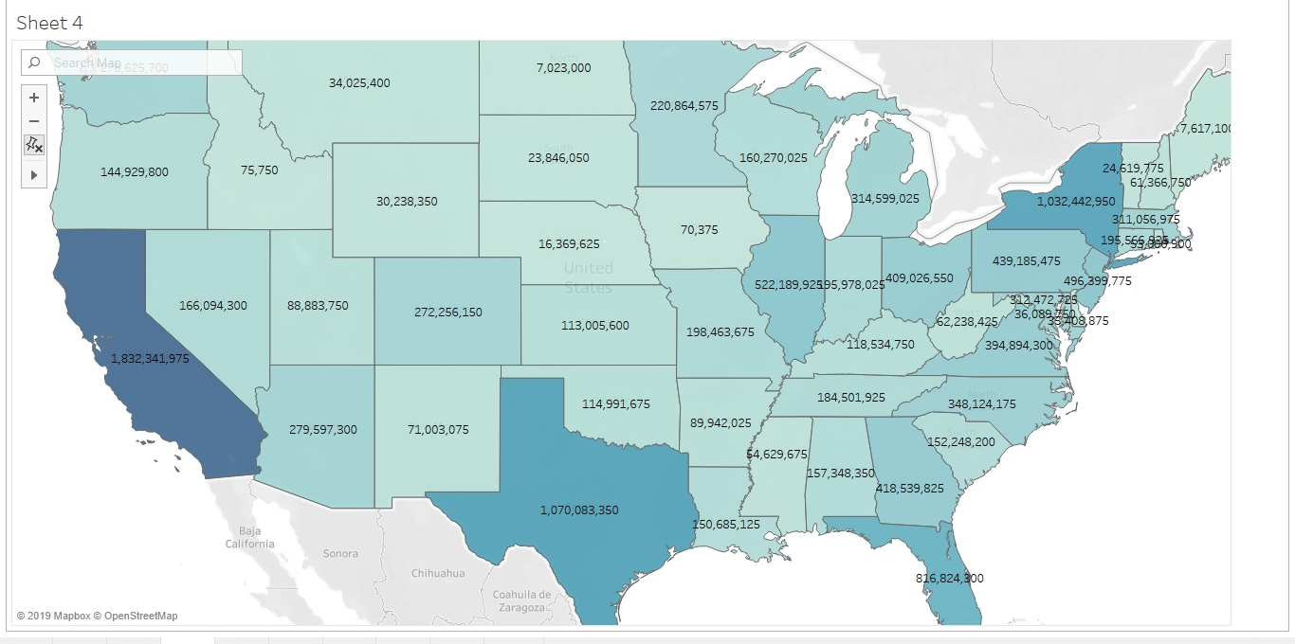
Country Wise Loan Disbursement

Slide 14
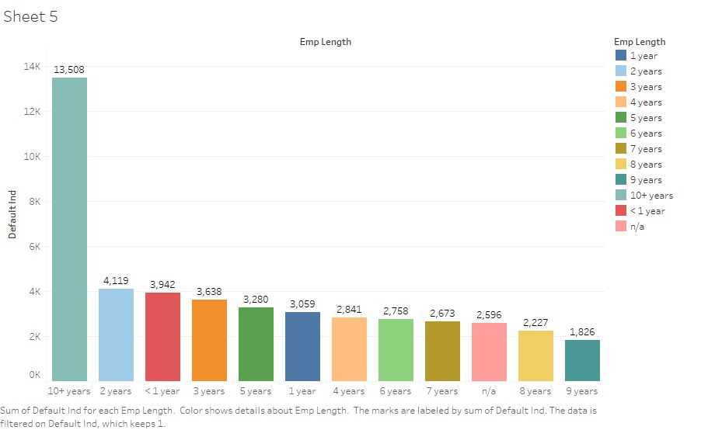
Years of Experience Versus Default Status

Slide 15
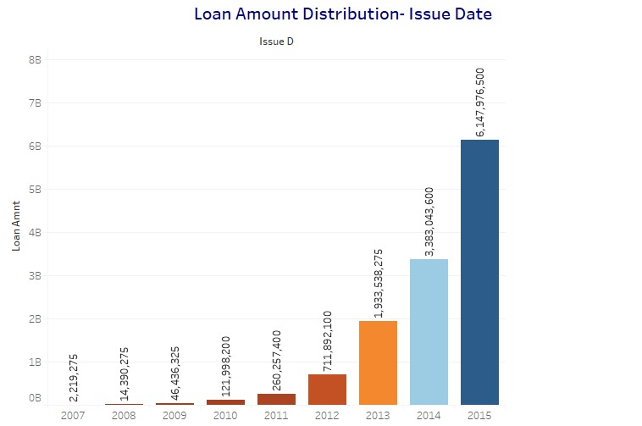
Loan Amount Distribution Yearwise

Slide 16
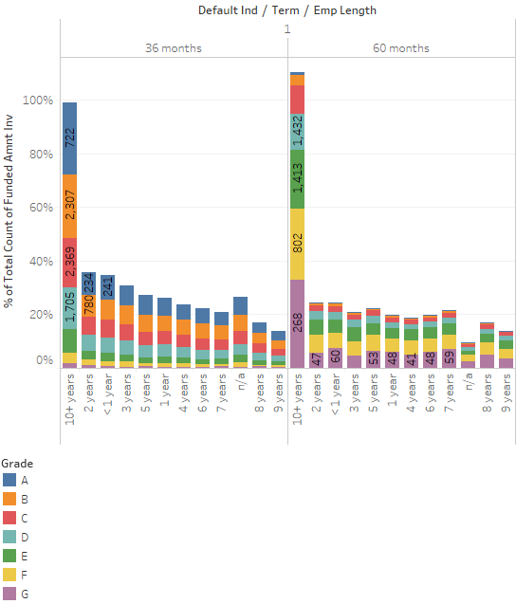
Borrower with 10+year of experience are maximum Defaulter

Slide 17
Insights
~ 90% of funding is done for the purpose of top 4 reason viz. debt Consolidation, Credit card, Home improvement
The higher the interest rate is charged to low grade borrowers which has more likelihood of being defaulter
Loans with term of 36 months tended to be defaulted more even for grade A to D
Borrower with 10 year+ and 2 year of experience are maximum defaulters

Slide 18
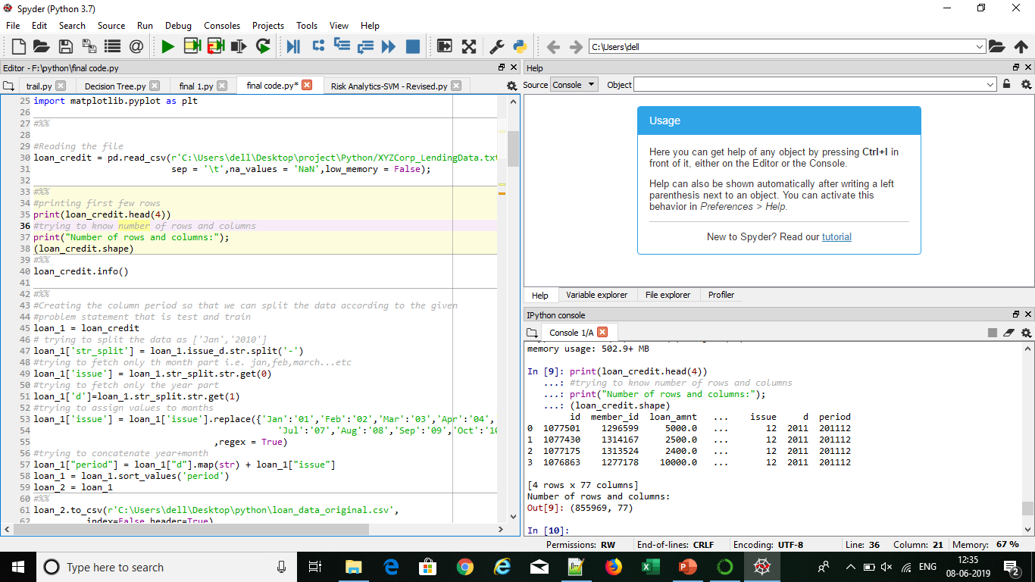
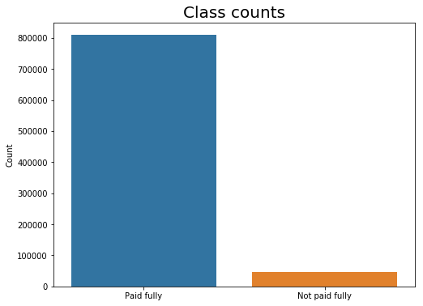
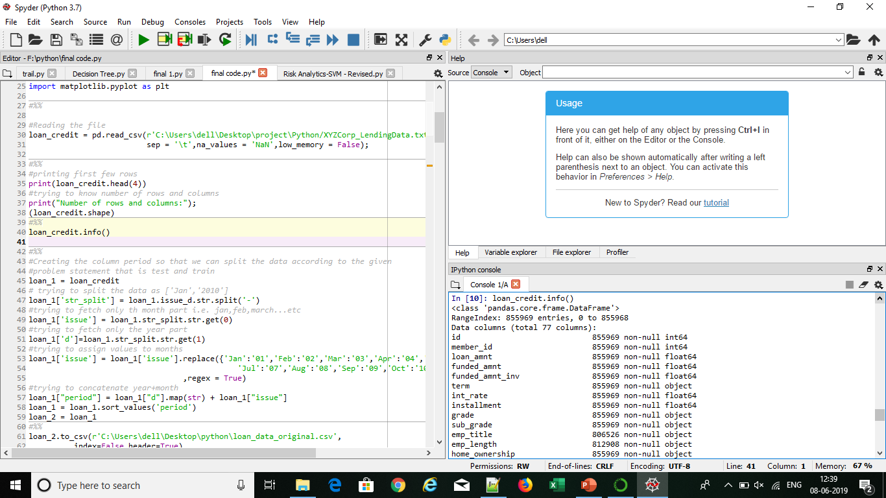
Data Preparation and Processing
Importing the data set
Identifying number of rows , columns and data type of variables.
Class 1 | Class 0
46467 | 809502

Slide 19
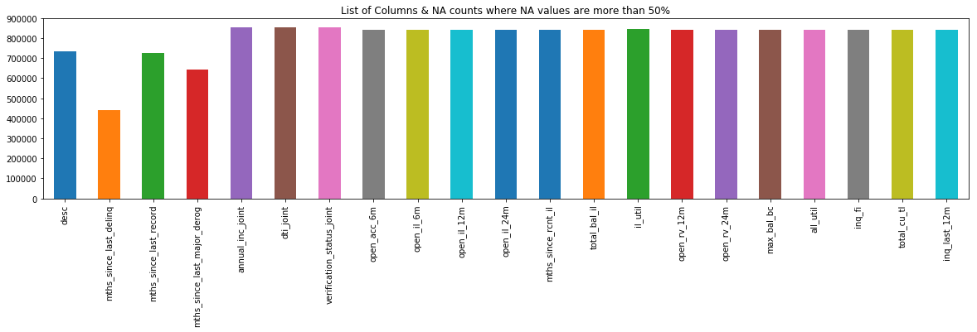
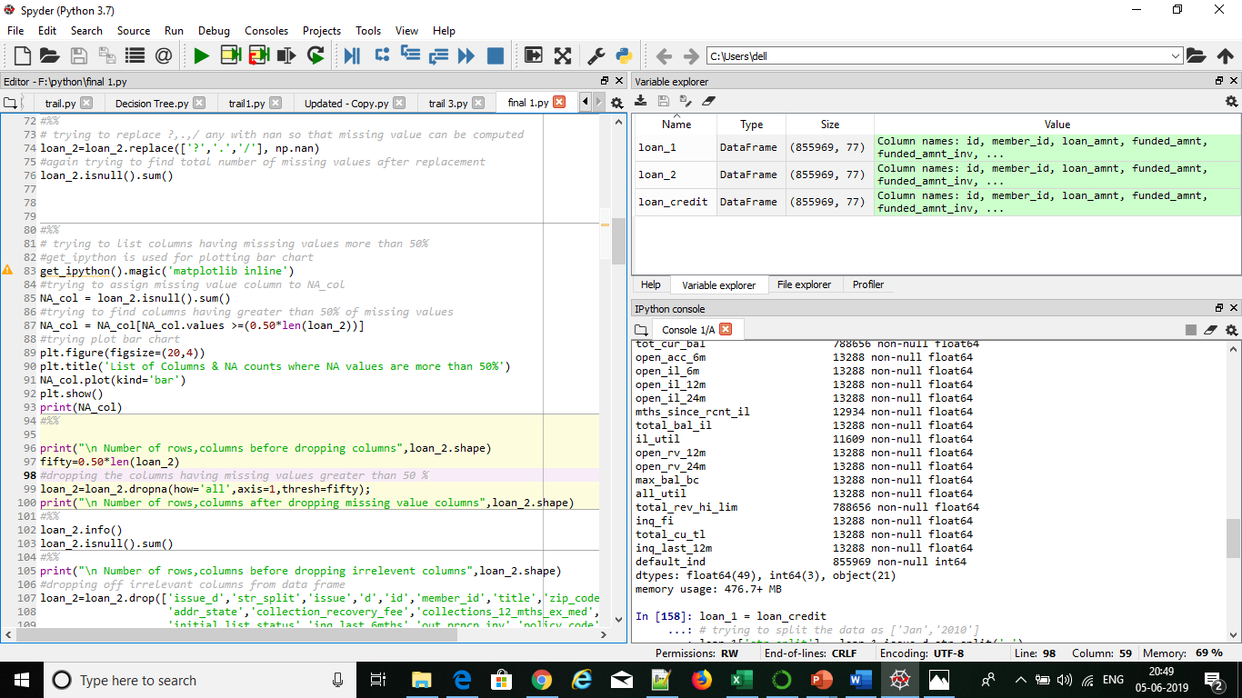
Removed columns having greater than 50% missing values
Number of rows, columns before dropping missing columns (855969, 76)
Number of rows, columns after dropping missing value columns (855969, 55)

Slide 20
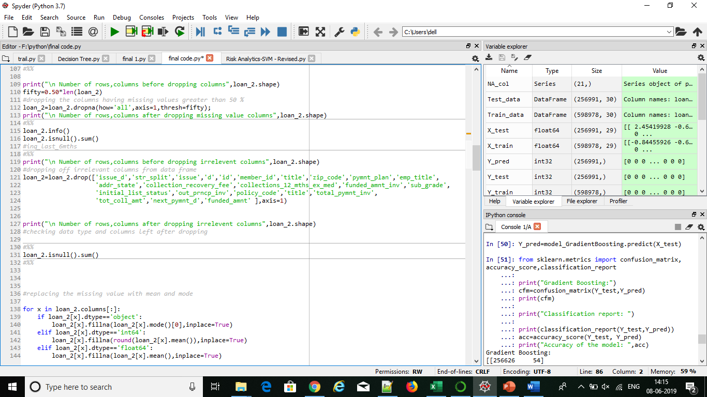
Removed columns that had no relationship with analysis (id,title zip code etc.).
Removed columns that had identical relationship(ex. funded_amt and funded_amt_inv is same as loan_amt).
Number of rows, columns before dropping irrelevant columns (855969, 55)
Number of rows, columns after dropping irrelevant columns (855969, 32)

Slide 21
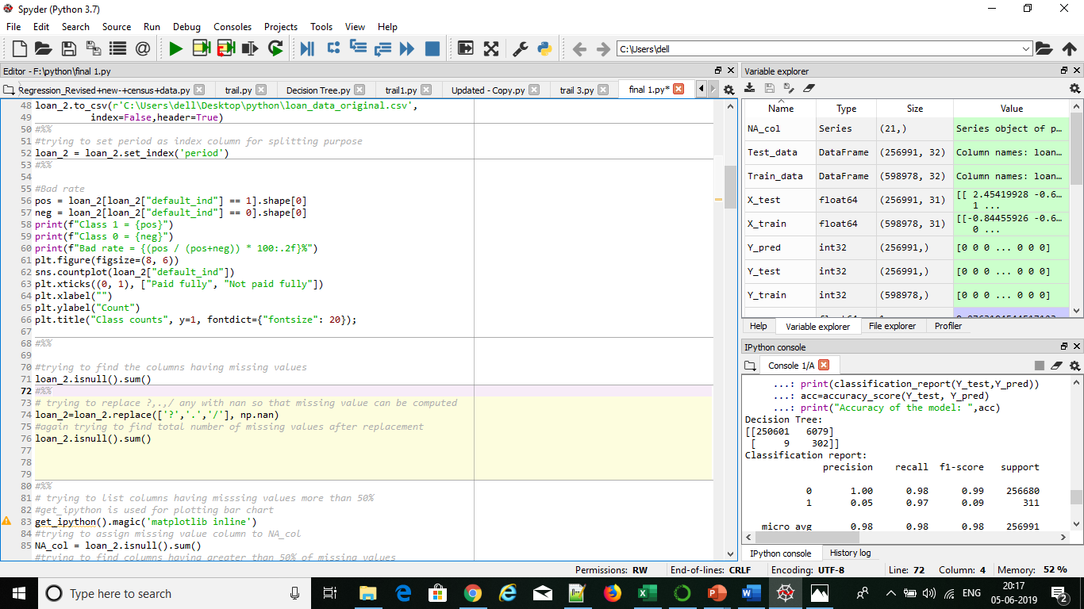
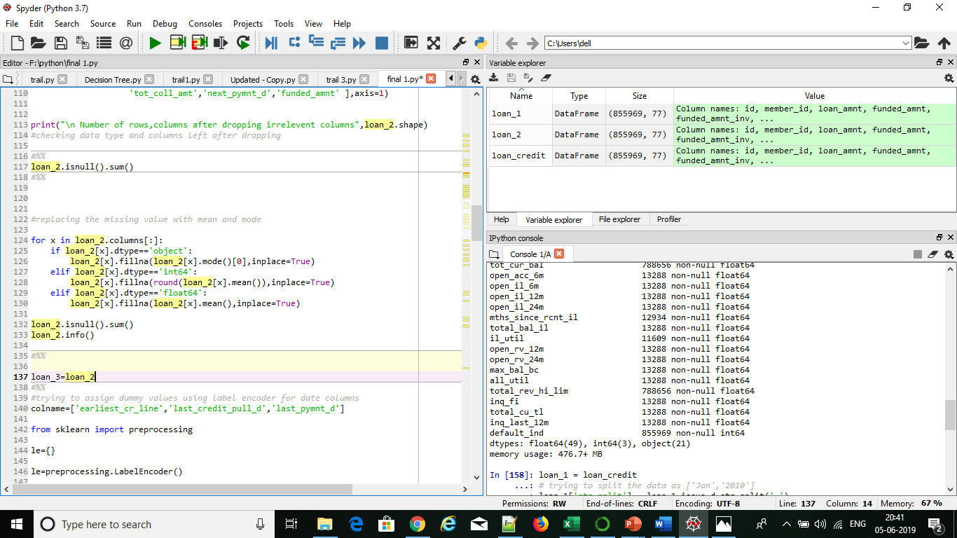
Missing Value Treatment
Replacing ?,.,/ if any with nan in order to treat missing values and computing total number of missing values in each column.
Replacing missing value of object data type with mode and integer/float data type with mean.

Slide 22
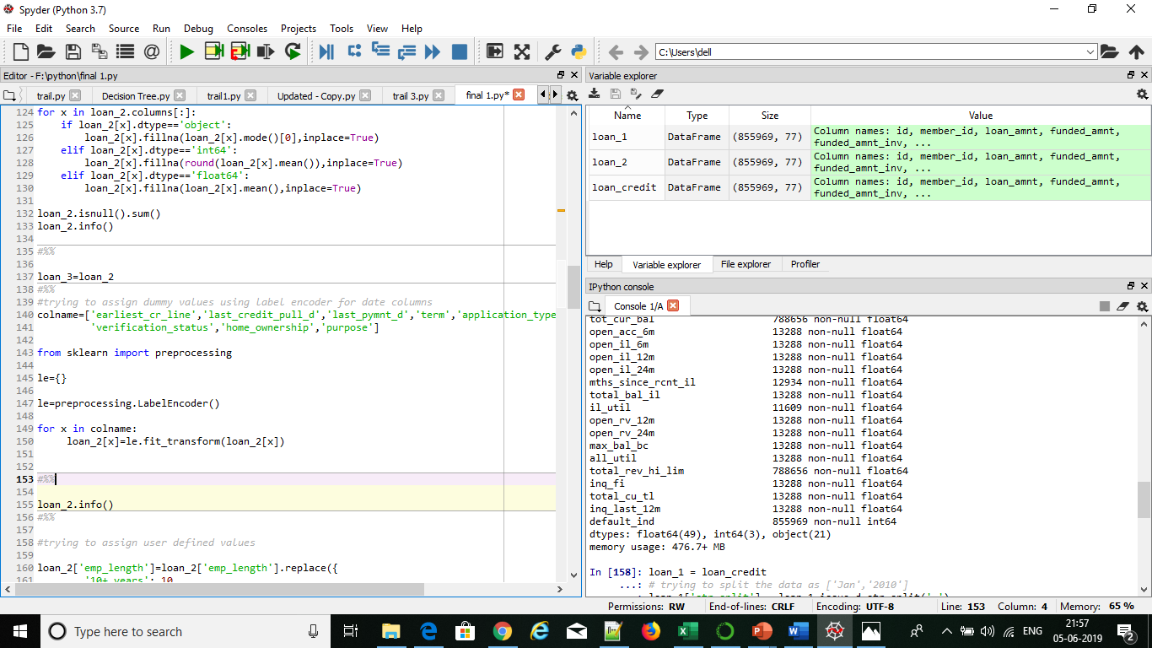
Two types of categorical are available in our dataset:
Ordinal variables : grade, emp_length
Nominal variables:,last_credit_pull_d,last_pymnt_d,term,application_type, verification_status , home_ownership, purpose, earliest_cr_line
Assigning dummy values to all the categorical variables using below two techniques:
Label Encoding
Used to replace nominal variables
Assigns values in ascending order of alphabets

Slide 23
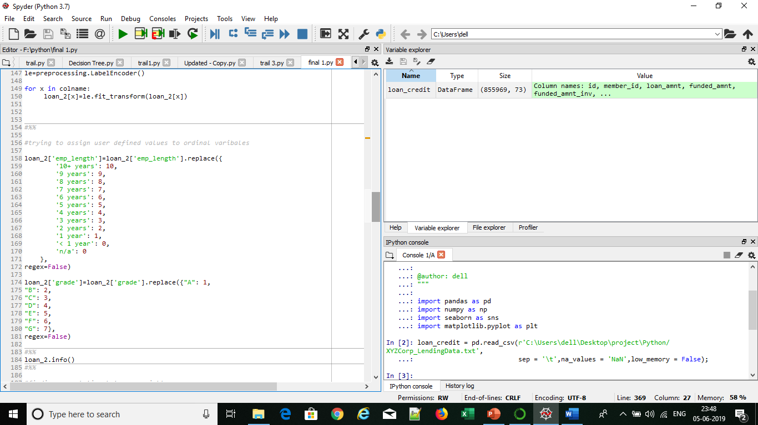
Replace method
Used to replace nominal variables
Used to assign user defined values

Slide 24
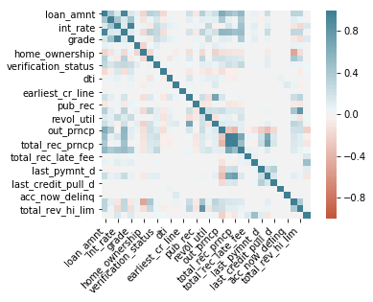
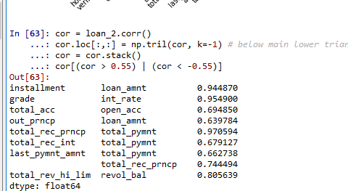
Finding if high correlation ship exits between the variables:
From below output it is clear that high correlation exist between instalment and loan_amt, grade and int_rate, total_rec_prncp and total_pymnt and total_rev_hi_lim and revol_bal.

Slide 25
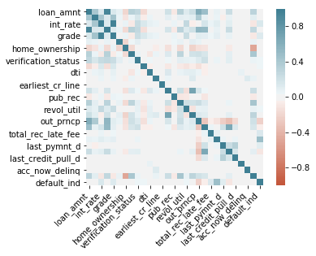
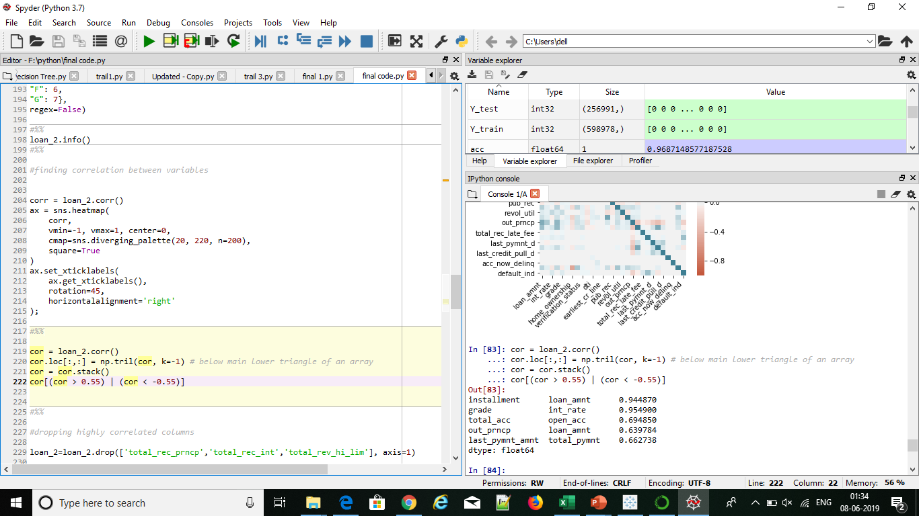
Dropping highly correlated variables
Here we retain int_rate,grade ,instalment and loan_amt from business perspective even though they are highly correlated.

Slide 26
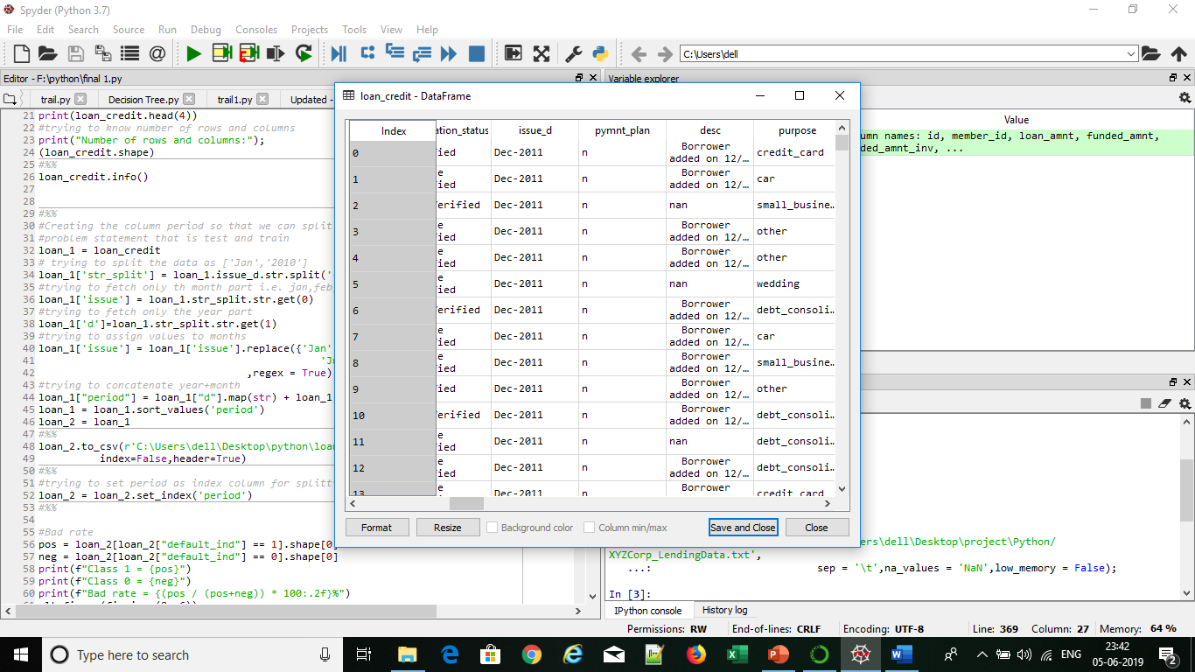
Splitting the data into Train and Test
According to the problem definition we will split the data into train and test on the basis of issue_d.
Train (June 2007 - May 2015) and Test (June 2015 - Dec 2015) data.
Format of issue_d in original dataset is :

Slide 27
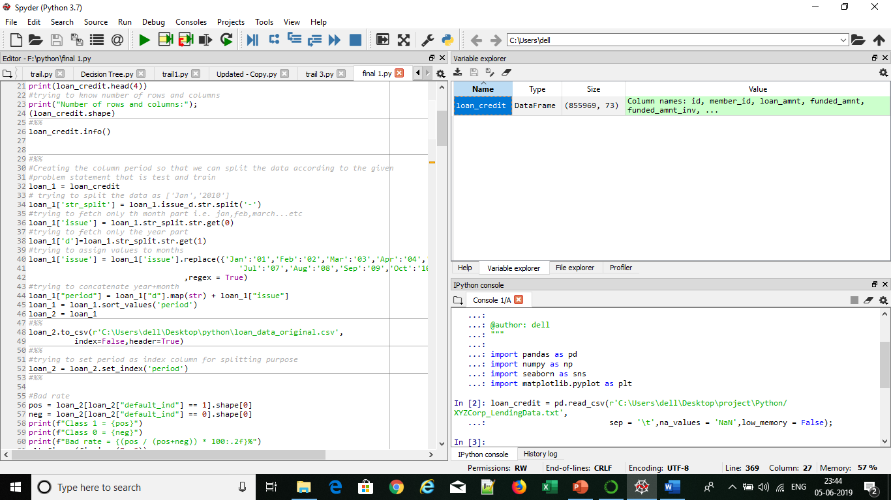
Here we try to split the date variable and convert into a integer variable (period) for splitting purpose :
We set the newly created column period as index.

Slide 28
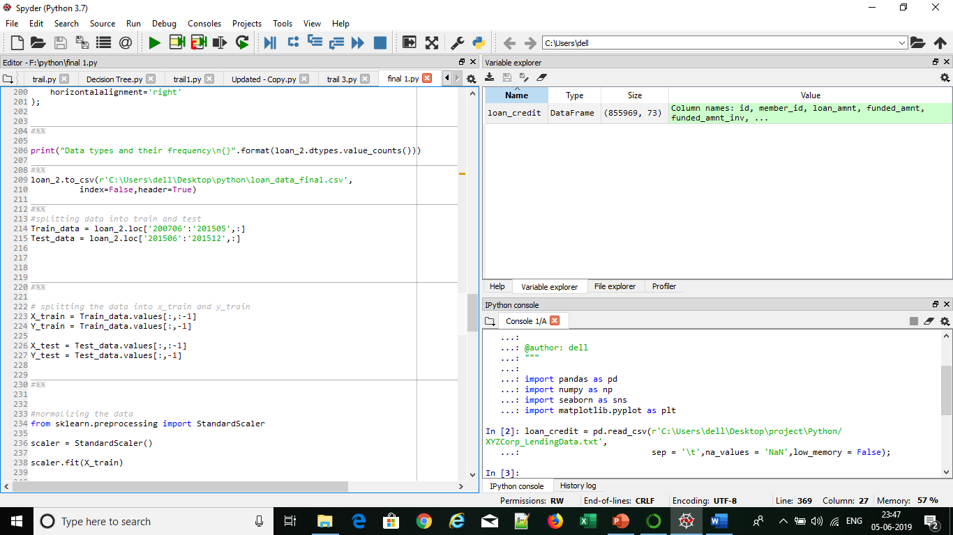
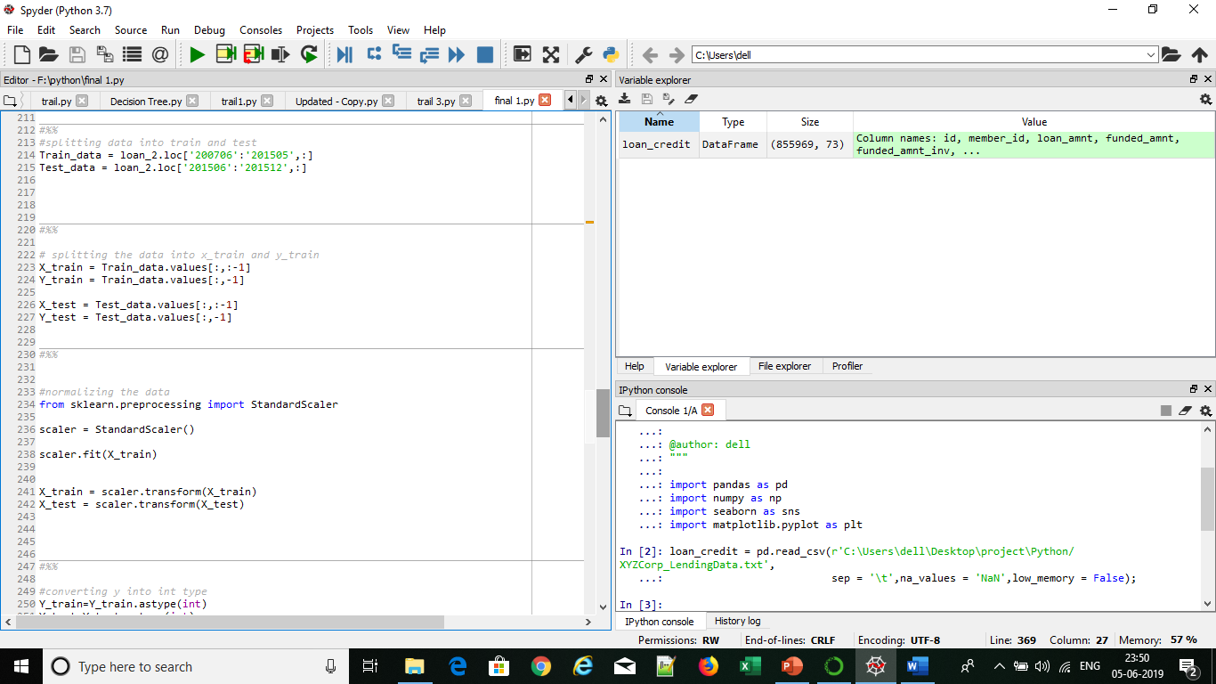
Then the split the data in train and test as below:
Then we split the data further into X_train, X_test , Y_train and Y_test for model building as below:

Slide 29
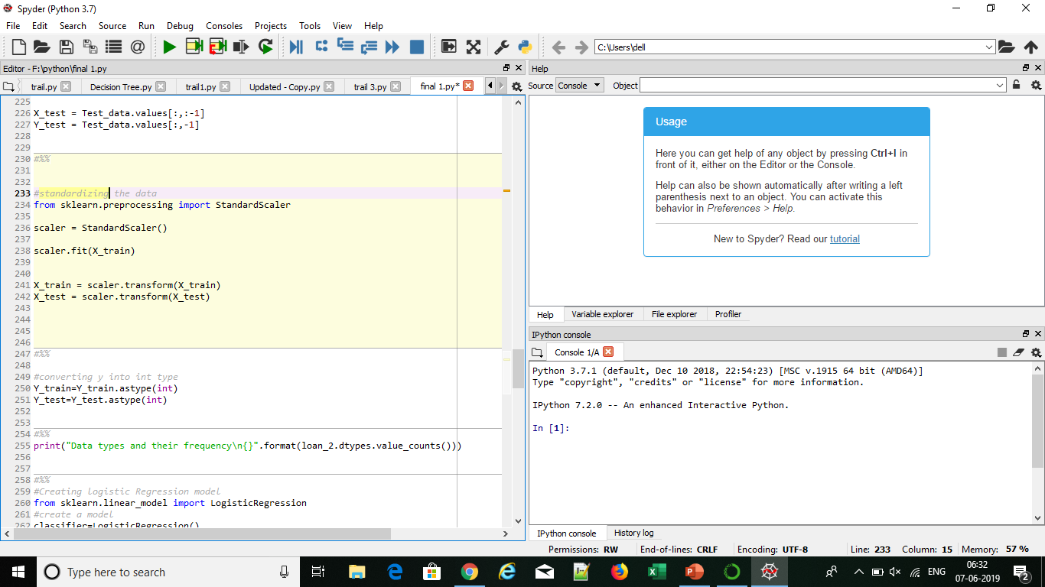
Then we perform standardization of data
It transform attributes with a Gaussian distribution and differing means and standard deviations to a standard Gaussian distribution with a mean of 0 and a standard deviation of 1.

Slide 30
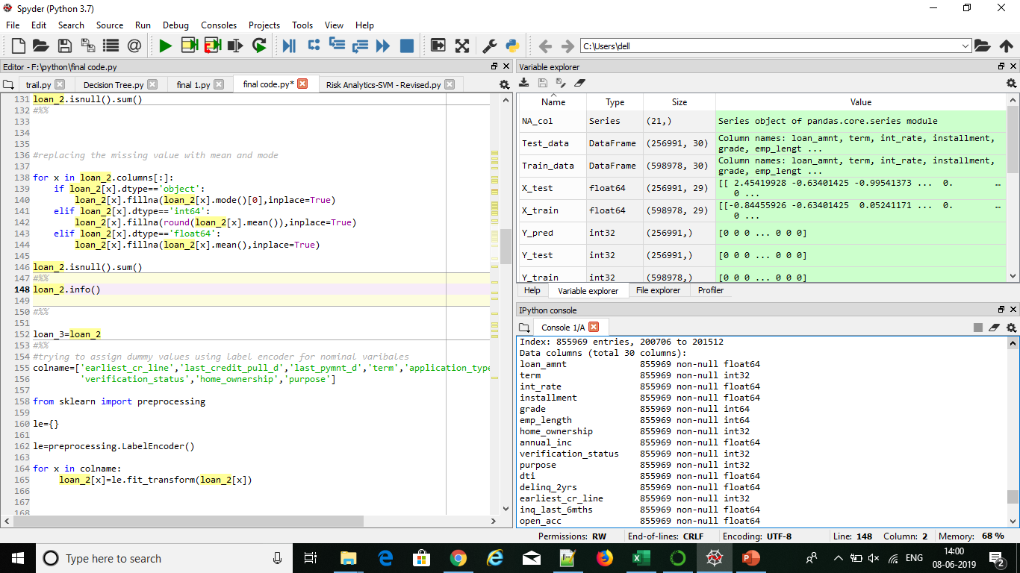
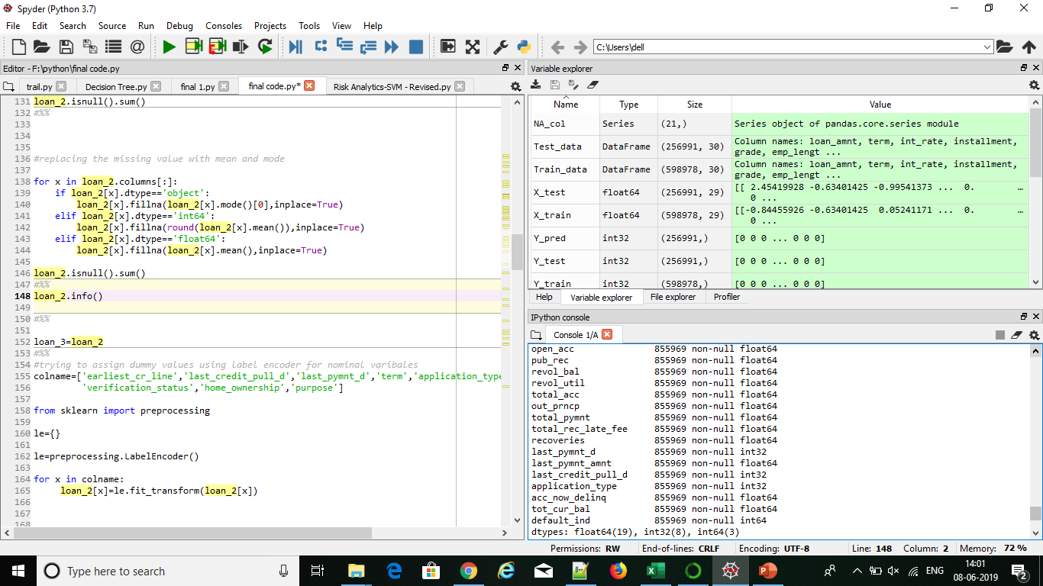
Final variables that will be used for model building.
We have reduced down from 77 variables to total 30 variables for model building

Slide 31
Model Building
We selected four data models to determine which returned the best predictive capability. We utilized few assessment parameters to determine the most successful model, to include:
Models
Logistic Regression
Decision Tree
Ensemble methods
Bagging (Random Forest)
Boosting(Gradient Boosting)
Assessment Parameters
Confusion matrix
Classification report
Confusion matrix

Slide 32
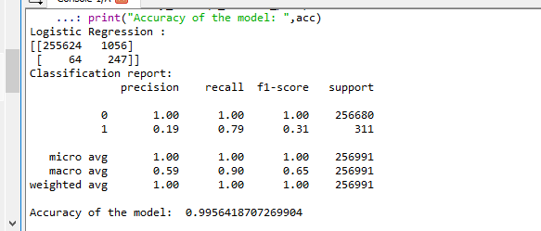
Logistic Regression
Accuracy is 99.56%.
In Logistic Regression even though type 2 error is 64 the precision for class 1 is 0.19 and recall is around 0.79 which is bit less.
Therefore we try running decision tree model.

Slide 33

Decision Tree
Accuracy is 97.62%.
In Decision Tree even though type 2 error is 9 the precision for class 1 is 0.05 and recall is around 0.97 which is bit less.
Also type 1 error is 6107 which is higher.
Therefore we try running ensemble methods bagging and boosting .

Slide 34
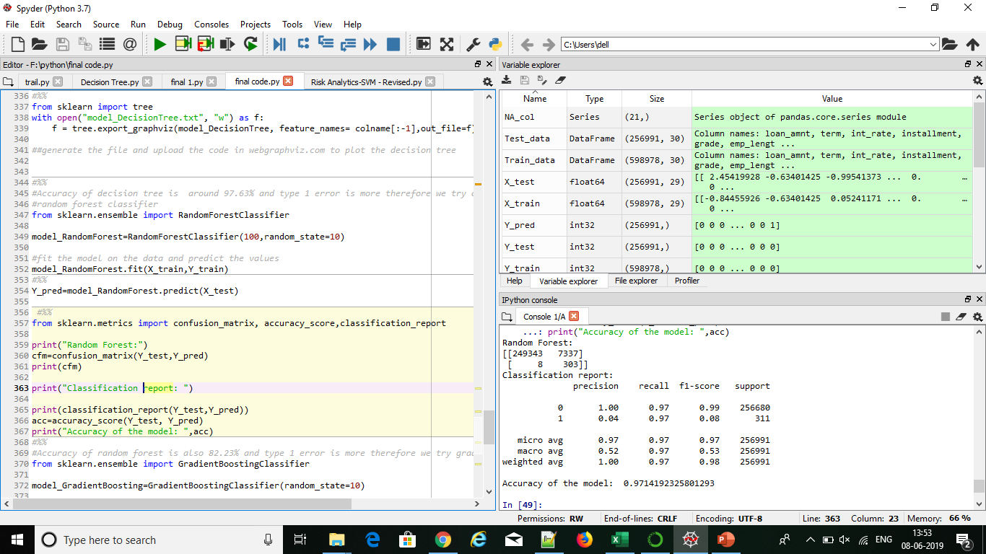
Random Forest
Accuracy is 96.87%.
In Random Forest even though type 2 error is 8 the precision for class 1 is 0.04 and recall is around 0.97 which is bit less.
Also type 1 error is 7337 which is higher.

Slide 35
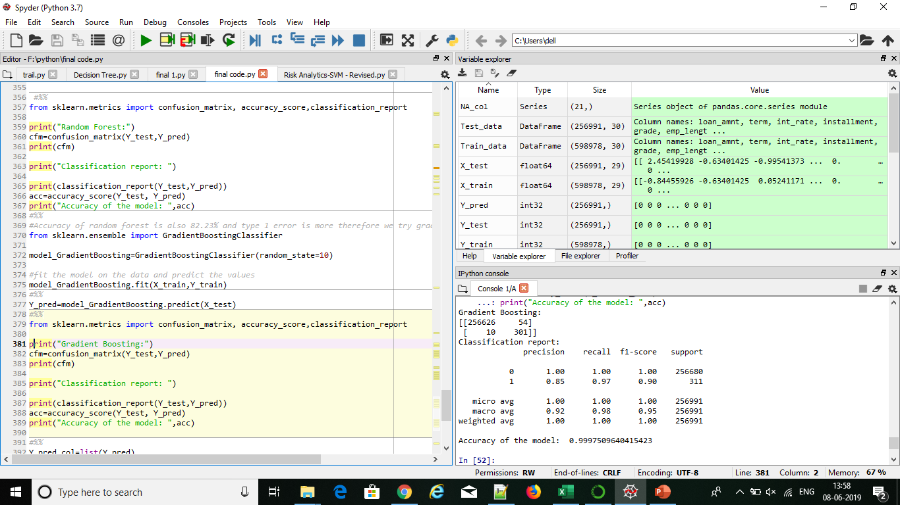
Gradient Boosting
Accuracy is 99.17%.
In Gradient boosting type 2 error is 10 and type 1 is 54 which is very less as compared to other previous models.
Also precision and recall rate are good.

Slide 36
Model Comparison
Model | Type 1 error | Type 2 error | Precision | Recall | Accuracy
Logistic Regression | 1056 | 64 | Class 0: 1.00 Class 1: 0.19 | Class 0: 1.00 Class 1: 0.79 | 99.56%.
Decision Tree | 6107 | 9 | Class 0: 1.00 Class 1: 0.05 | Class 0: 0.98 Class 1: 0.97 | 97.61%
Random Forest | 7337 | 8 | Class 0: 1.00 Class 1: 0.04 | Class 0: 0.97 Class 1: 0.99 | 96.87%
Gradient Boosting | 54 | 10 | Class 0: 1.00 Class 1: 0.85 | Class 0: 1.00 Class 1: 0.97 | 99.97%

Slide 37
Conclusion
As seen from the comparison results Gradient Boosting Technique performs well than other models with minimal type 2 error and accuracy as 99.97%.
Hence based on model prediction we can conclude that 99.97% chance that customer will not default on loan.
Intuitively, loan default cases are attributable to total principal received, outstanding principal, and last payment date. A higher principal would imply higher risk of default

Slide 38
Recommendations
Choose borrower with High grade .
Choose loans for 60 month terms.
Need to focus on debt consolidated loans.
Credit Scores are missing in data set which could have proved more useful in predicting.

Slide 39
THANK YOU ☺

